Slide 1

Integrating Thorlabs Device in MATLAB
Wolfgang Skopalik

Slide 2
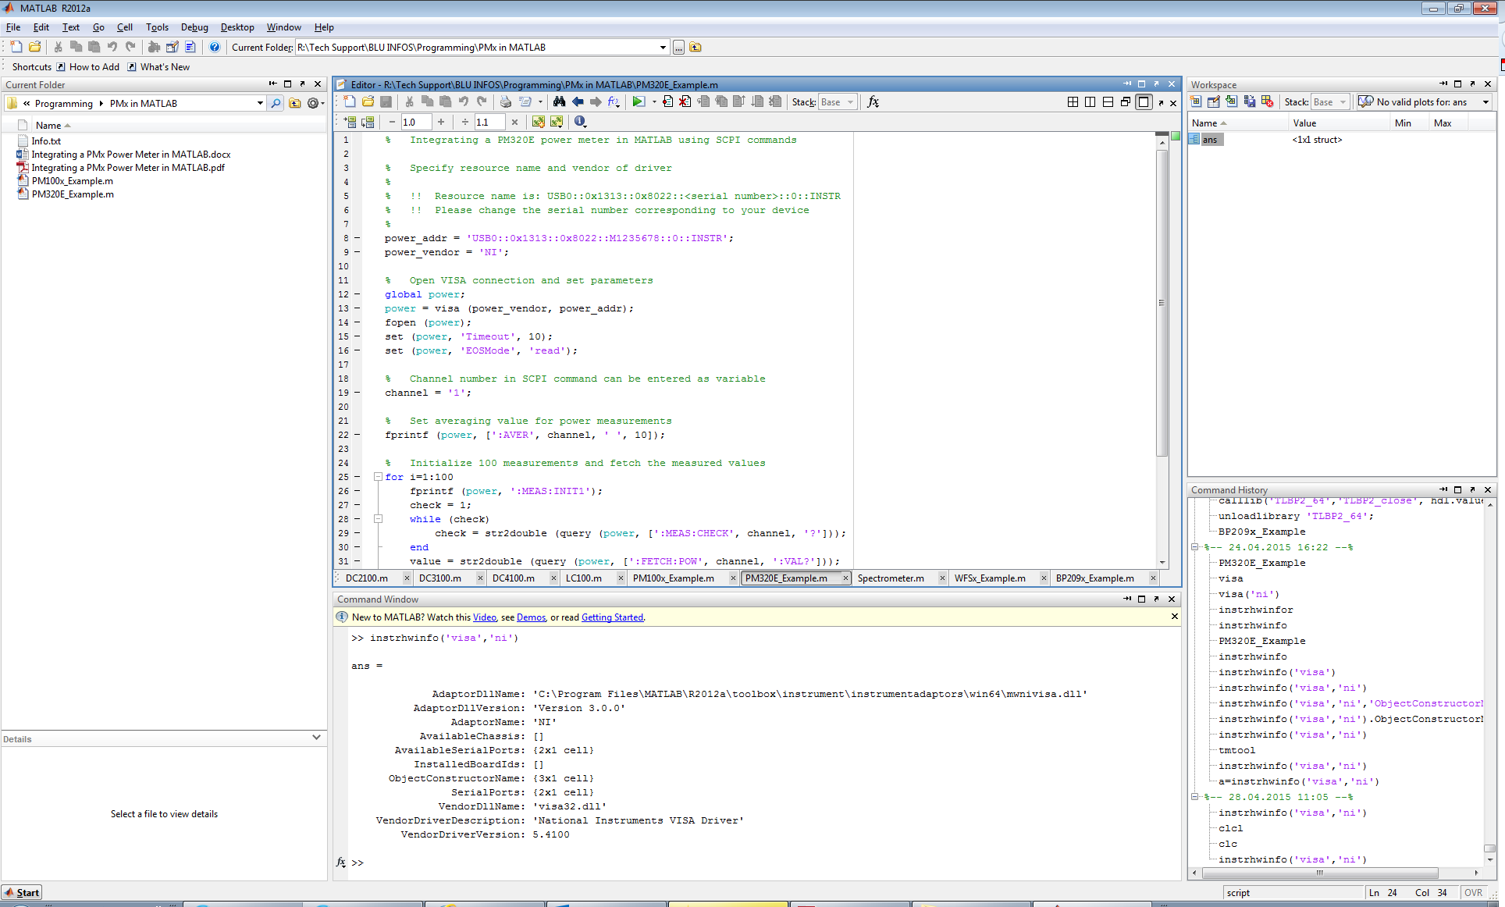
MATLAB Overview

Slide 3
Different ways
There are different ways to integrate devices in MATLAB:
Driver files (.dll, .lib): CCSx, WFSx
SCPI commands: PM100x, PM200, PM320E
Serial COM commands: DCx LED driver
For these devices sample codes are available.
In MATLAB generally low-level commands are easier to use.
But for some devices the driver files are the only way.

Slide 4
General approach
The general approach is similar for each of these ways:
Get connection to the device
Perform measurement / switching / read out
Close connection to the device in the end

Slide 5
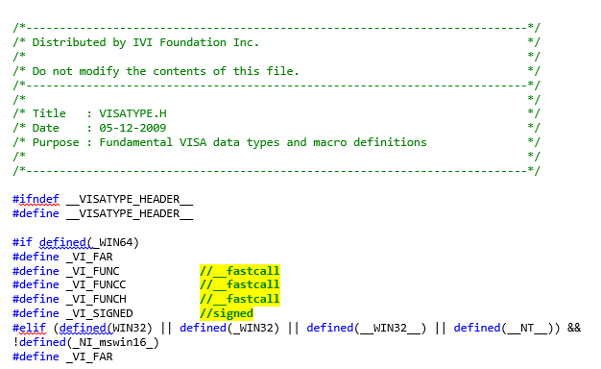
Driver files
To use driver files in MATLAB, in most cases the header file „visatype.h“ has to be modified like this:
Comment out the calling conventions for 64-bit systems.
MATLAB / Compiler doesn‘t support them and returns an error message.

Slide 6
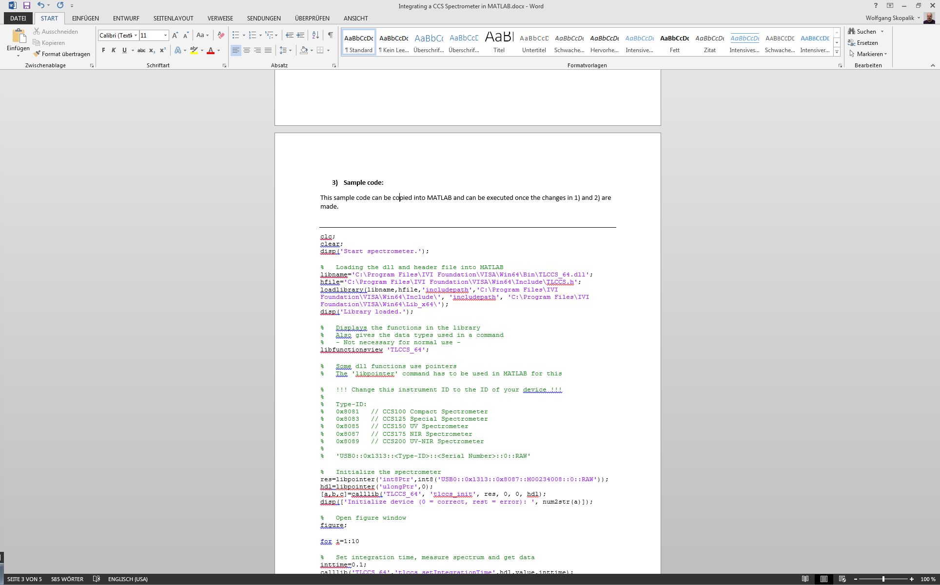
Driver files
Sample code for CCS:
Loading the library into MATLAB
Show functions in the driver
Initialize the device with correct instrument ID

Slide 7
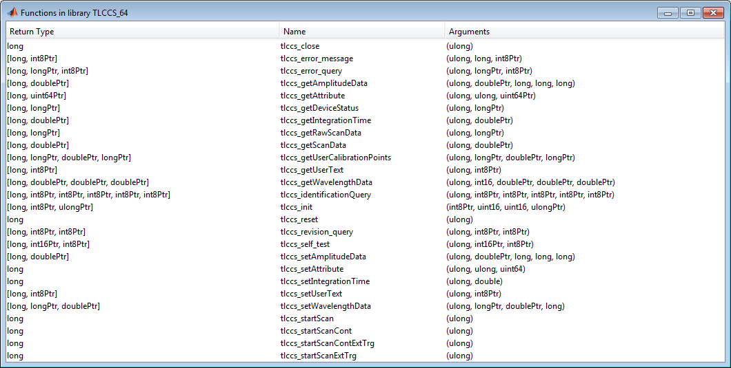
Driver files
Pointers in MATLAB:
All of our drivers use pointers in some functions
In MATLAB pointers are created by „libpointer“
Correct „libpointer“ type can be seen in „libfunctionsview“

Slide 8
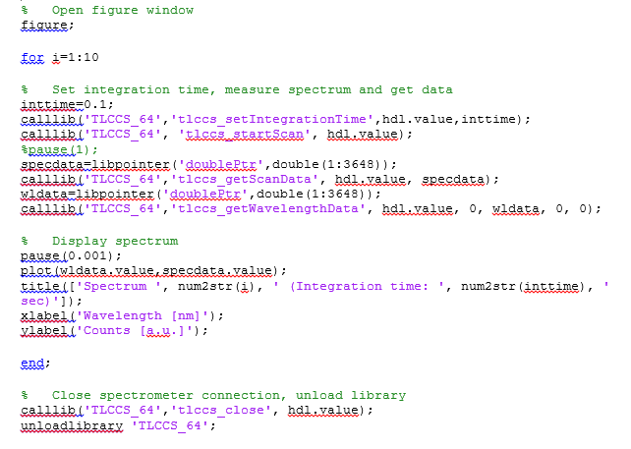
Driver files
Sample code for CCS:
Set integration time and make a scan
Show the scan data
Close the connection to the device

Slide 9
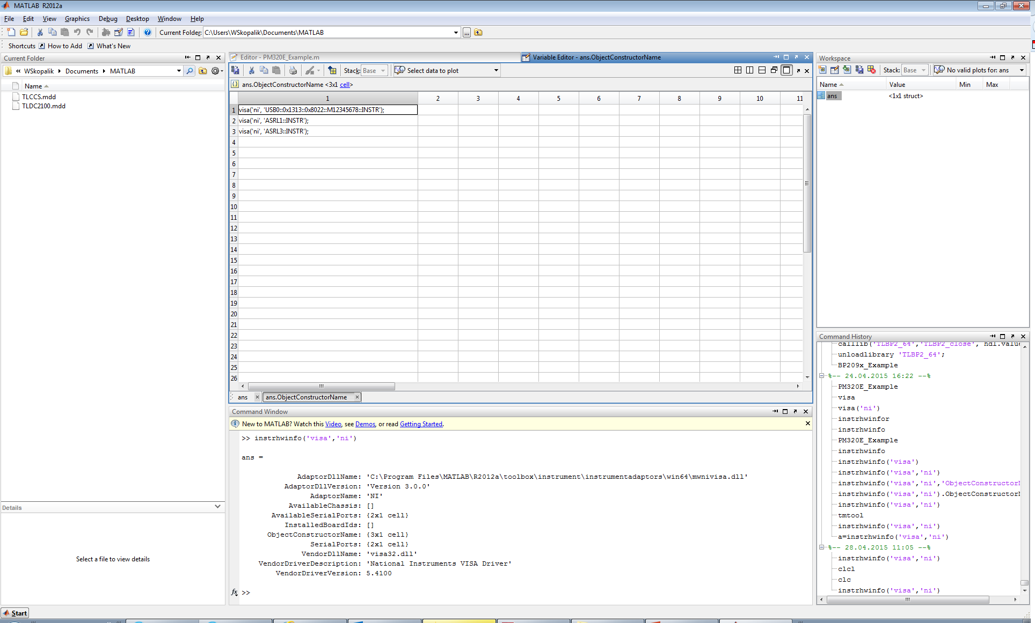
SCPI commands
For SCPI commands the VISA interface has to be installed

Slide 10
SCPI commands
For SCPI commands the VISA interface has to be installed

Slide 11
SCPI commands
For SCPI commands the VISA interface has to be installed
Resource name of device

Slide 12
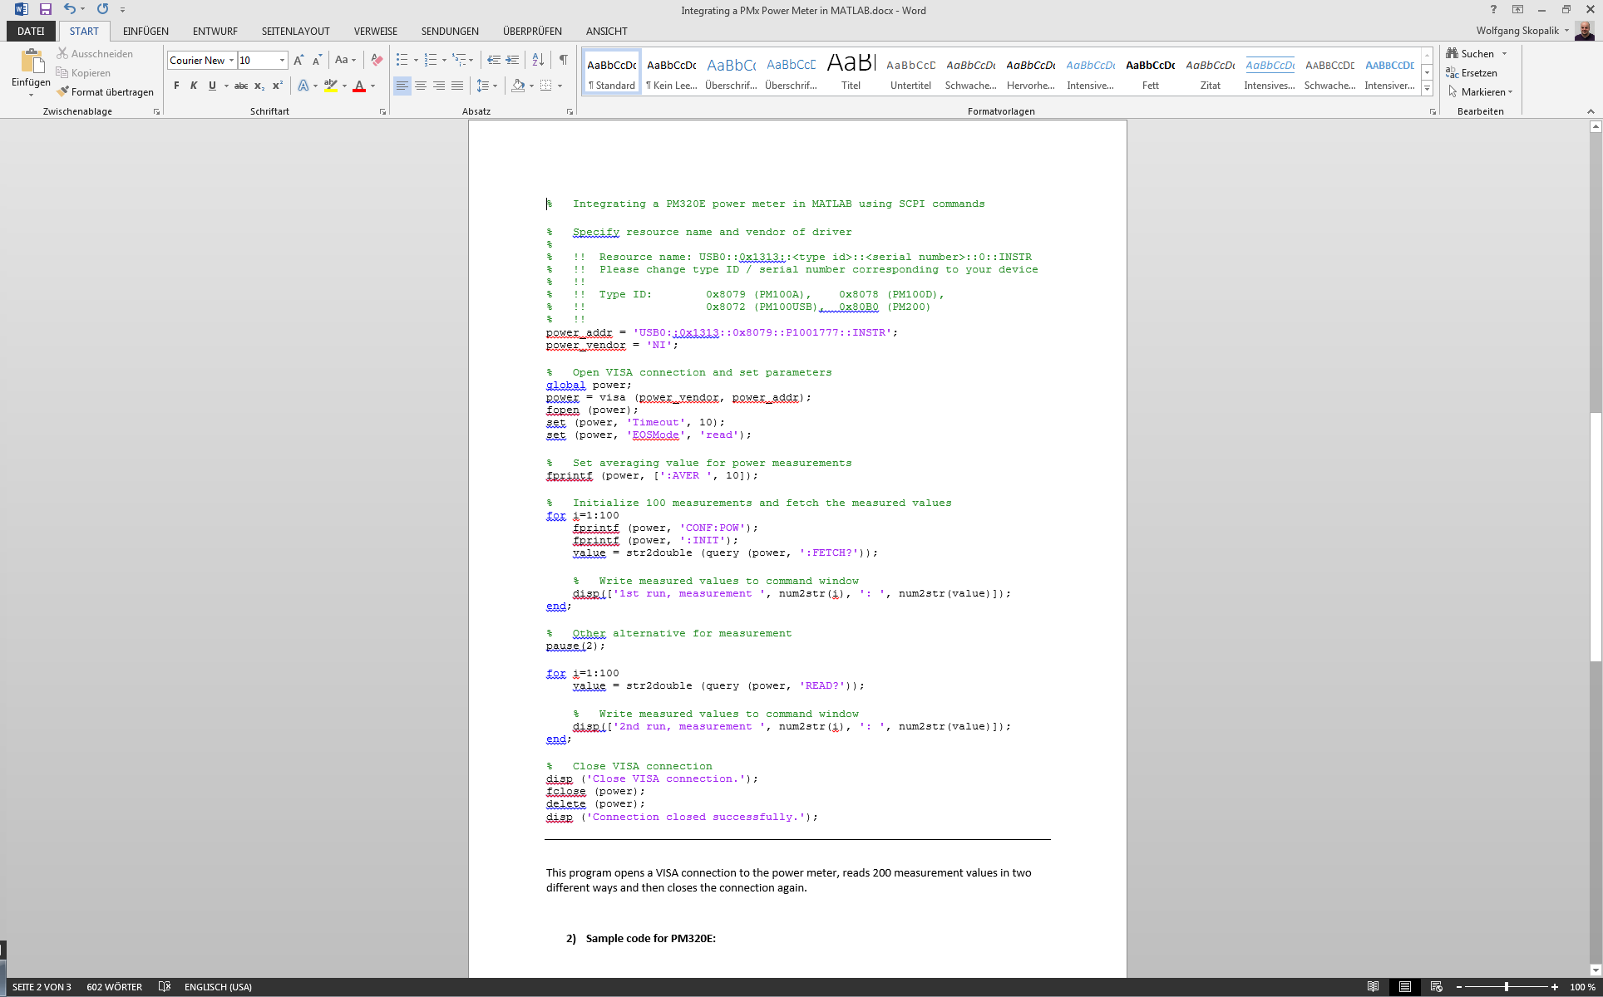
SCPI commands
Sample code for PM100A:
Set correct resource name
Open VISA session
Set connection parameters

Slide 13
SCPI commands
Sample code for PM100A:
Set different measurement parameters
Two different ways to read values
Close VISA session

Slide 14
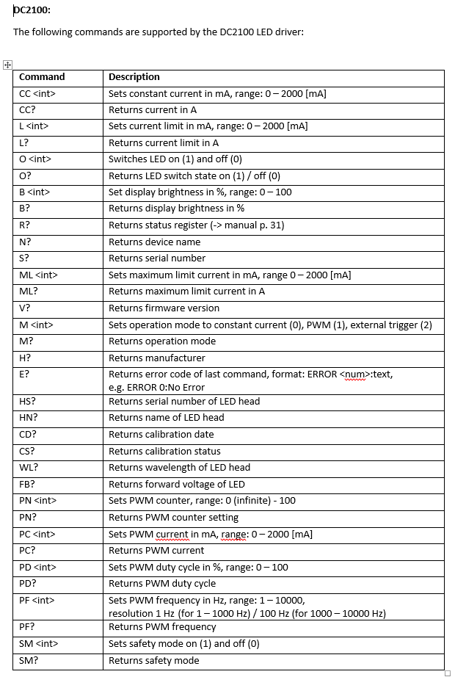
Serial COM commands
Each DCs LED driver has a list of commands for the COM interface.
The lists are included in the documentation.

Slide 15
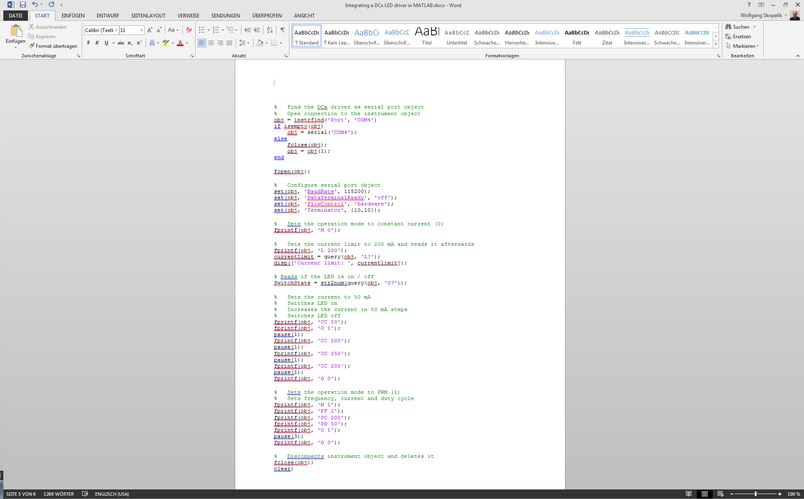
Serial COM commands
Sample code for DC2100:
COM port has to be known (e.g. device manager)
Open serial port connection
Set connection parameters

Slide 16
Serial COM commands
Sample code for DC2100:
Operation mode, current, etc. can be set and read out by these commands
Different commands for CC or PWM
Close serial port connection in the end

Slide 17
Additional information
You can find all the programming documentations and sample codes in this folder: R:\Tech Support\BLU INFOS\Programming
Thank you! Questions?

